Slide 1


Mohamed Hafedh Ibrahim
31/08/2022

Slide 2

Outline
Executive Summary
Introduction
Methodology
Results
Conclusion
Appendix

Slide 3
Executive Summary
Four classification algorithms will be tested on SpaceX data in order to predict the success of rockets landing.
The data will be collected and cleaned. Different chart will be displayed to understand the data then the best classifier will be chosen to predict the success of rockets landing.

Slide 4
Introduction
SpaceX advertises Falcon 9 rocket launches on its website with a cost of 62 million dollars; other providers cost upward of 165 million dollars each, much of the savings is because SpaceX can reuse the first stage. Therefore, if we can determine if the first stage will land, we can determine the cost of a launch. This information can be used if an alternate company wants to bid against SpaceX for a rocket launch.
This project aims to predict if the Falcon 9 first stage will land successfully depending on different parameters such as launch site, payload mass, etc.

Slide 5

Section 1

Slide 6
Methodology
Executive Summary
Data collection methodology:
Describe how data was collected
Perform data wrangling
Describe how data was processed
Perform exploratory data analysis (EDA) using visualization and SQL
Perform interactive visual analytics using Folium and Plotly Dash
Perform predictive analysis using classification models
How to build, tune, evaluate classification models

Slide 7
Data Collection Methodology
Request and parse the SpaceX launch data using the GET request
Filter the dataframe to only include Falcon 9 launches
Clean the data

Slide 8
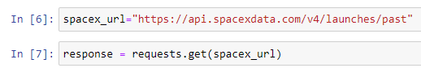
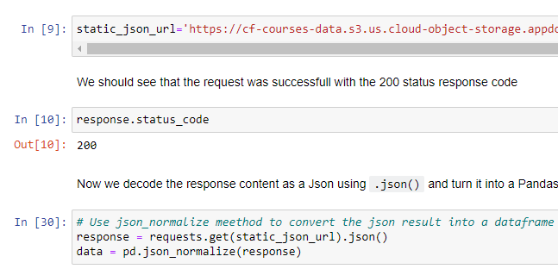
Data Collection – SpaceX API
Request and parse the SpaceX launch data using the GET request
Convert the json result into a pandas dataframe
For more details:
Data Collection – SpaceX API

Slide 9
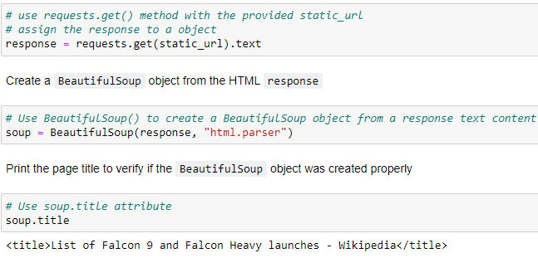
Data Collection - Scraping
Request the Falcon9 Launch Wiki page from its URL
Extract all column/variable names from the HTML table header
Create a data frame by parsing the launch HTML tables
For more details:
Data Collection - Scraping

Slide 10

Data Wrangling
Calculate the number of launches on each site
Calculate the number and occurrence of each orbit
Calculate the number and occurrence of mission outcome per orbit type
Create a landing outcome label from Outcome column
For more details:
Data Wrangling

Slide 11
EDA with Data Visualization
Visualize the relationship between Flight Number and Launch Site
Visualize the relationship between Payload and Launch Site
Visualize the relationship between success rate of each orbit type
Visualize the relationship between FlightNumber and Orbit type¶
Visualize the relationship between Payload and Orbit type
Visualize the launch success yearly trend
For more details:
EDA with Data Visualization

Slide 12
EDA with SQL
Display the names of the unique launch sites in the space mission
Display 5 records where launch sites begin with the string 'CCA'
Display the total payload mass carried by boosters launched by NASA (CRS)
Display average payload mass carried by booster version F9 v1.1
List the date when the first succesful landing outcome in ground pad was achieved.
List the names of the boosters which have success in drone ship and have payload mass greater than 4000 but less than 6000
List the total number of successful and failure mission outcomes
List the names of the booster_versions which have carried the maximum payload mass.
List the records which will display the month names, failure landing_outcomes in drone ship, booster versions, launch_site for the months in year 2015.
Rank the count of successful landing_outcomes between the date 04-06-2010 and 20-03-2017 in descending order.
For more details:
EDA with SQL

Slide 13
Build an Interactive Map with Folium
Mark all launch sites on a map
Mark the success/failed launches for each site on the map
Calculate the distances between a launch site to its proximities
For more details:
Build an Interactive Map with Folium

Slide 14
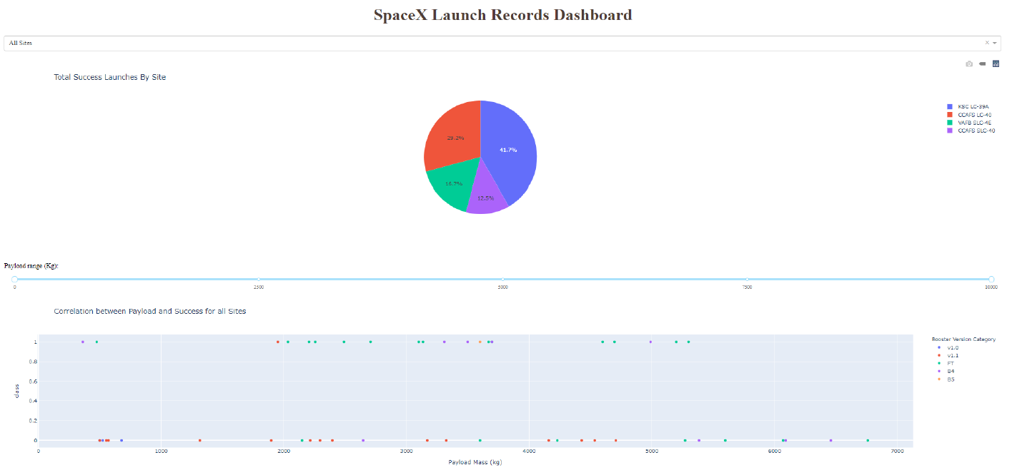
Build a Dashboard with Plotly Dash
The objective is to perform an interactive visual analytics on SpaceX launch data in real-time.
The Plotly Dash application is composed of two main divisions:
A dynamic pie chart of total success launches by site,
A dynamic scatter plot of correlation between Payload and success for all sites
For more details:
Build a Dashboard with Plotly Dash

Slide 15
Predictive Analysis (Classification)
Four classification algorithms were used to find the best classifier of landing success
K-Nearest Neighbors, Decision Tree, SVM and Logistic regression models were created, trained and evaluated.
Accuracy scores were compared in order to find the best classifier
For more details:
Predictive Analysis (Classification)

Slide 16
Results
Exploratory data analysis results
Interactive analytics demo in screenshots
Predictive analysis results

Slide 17

Section 2

Slide 18
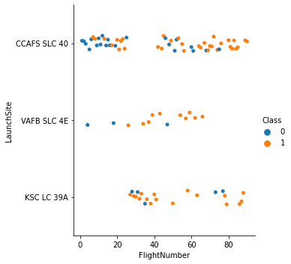
Flight Number vs. Launch Site
The first thing we can notice is that CCAFS SLC 40 is the launch site of most flights.
All the flights with flight number >= 80 are a success.
Most flights that are launched from VAFB SLC 4E are a success.

Slide 19
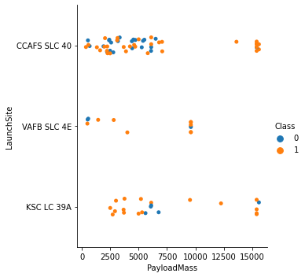
Payload vs. Launch Site
Most flights have a payload mass <8000 kg.
For VAFN SLC 4E launch site, there are not rockets launched for heavy payload (greater than 10000 kg).
Most flights with heavy payload mass (greater than 8000 kg) are a success.

Slide 20
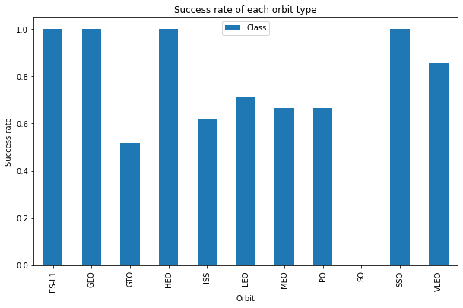
Success Rate vs. Orbit Type
The orbits ES-L1, GEO, HEO and SSO have a success rate of 100% while the flights targeting SO orbit never succeeded.

Slide 21
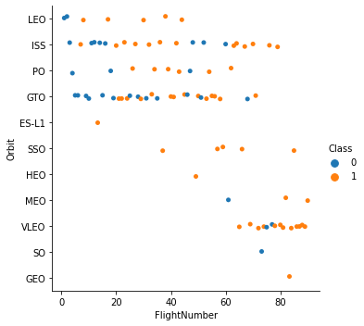
Flight Number vs. Orbit Type
The recent flights are essentially targeting the orbit VLEO.
The flights with number > 80 are a success.
Most of flights are targeting the orbits LEO, ISS, PO, GTO and VLEO.

Slide 22
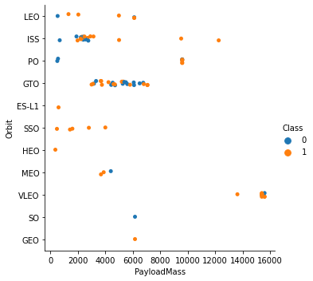
Payload vs. Orbit Type
The recent flights are essentially targeting the orbit VLEO.
The flights with number > 80 are a success.
Most of flights are targeting the orbits LEO, ISS, PO, GTO and VLEO.

Slide 23
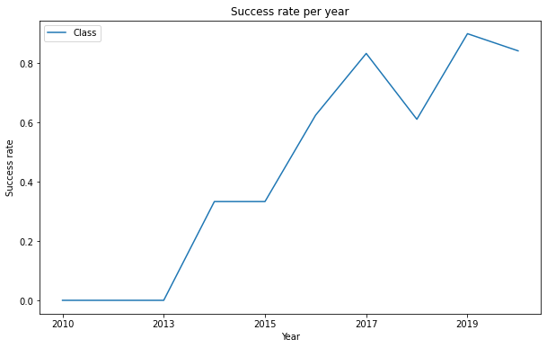
Launch Success Yearly Trend
Sucess rate since 2013 kept increasing till 2020

Slide 24
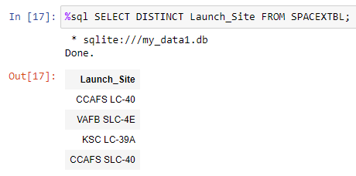
All Launch Site Names
We should add DISTINCT in order to have unique names of the different launch sites.

Slide 25
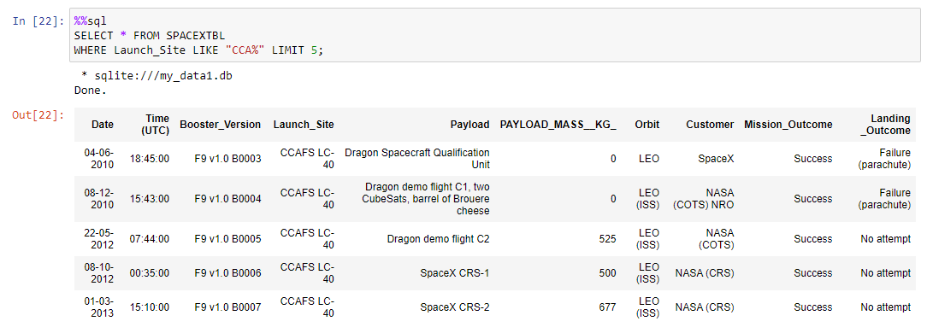
Launch Site Names Begin with 'CCA'
Adding LIKE “CCA%” enables to have launch site that begin with ‘CCA’
LIMIT 5 : limits the selection to 5 sites

Slide 26
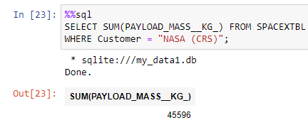
Total Payload Mass
We select the sum of payload mass with the condition that the customer is “NASA (CRS)”.
The total payload carried by boosters from NASA (CRS) is 45596 kg.

Slide 27
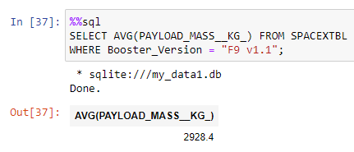
Average Payload Mass by F9 v1.1
We select the average of payload mass with the condition that Booster version is “F9 v1.1”.
The average payload carried by booster version “F9 v1.1” is 2928.4 kg.

Slide 28
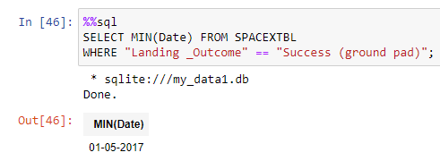
First Successful Ground Landing Date
We select the first date by selecting the minimum of dates.
As “Landing _Ouctome” is a complex name, we should put it between “”.

Slide 29
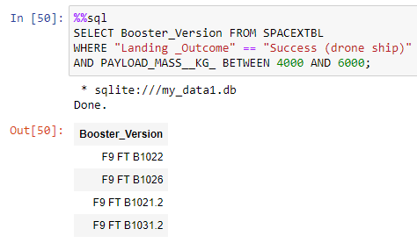
Successful Drone Ship Landing with Payload between 4000 and 6000
We select the booster version with the required conditions. We can use BETWEEN for the lower and upper limits of the payload_mass.

Slide 30
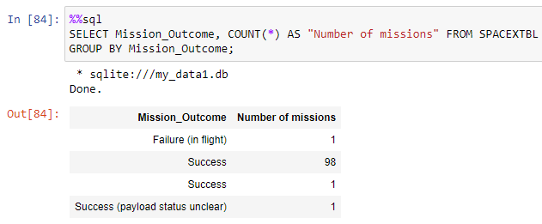
Total Number of Successful and Failure Mission Outcomes
We use GROUP BY in order to group the count of results by the mission_outcome.
We notice that Success is displayed twice as apparently there is a space added to “Success” for one row in the database. That’s why it was not grouped with the others.

Slide 31
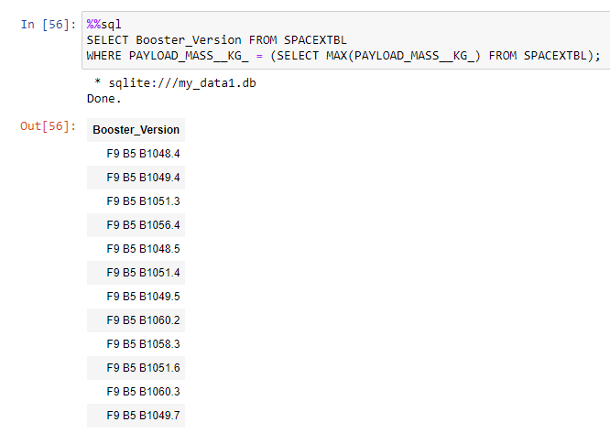
Boosters Carried Maximum Payload
We need a nested query in order to have the names of booster which have carried the maximum payload mass.

Slide 32
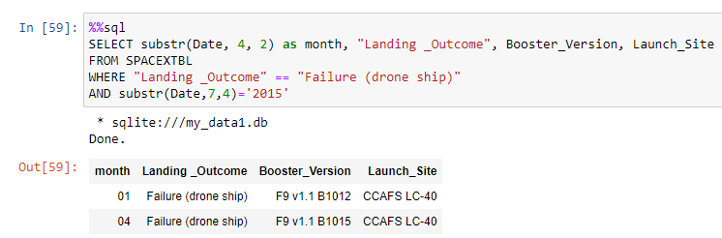
2015 Launch Records
Substr enables to extract the month and/or the year from the date which enables to have the failed landing_outcomes in drone ship, their booster versions, and launch site names for in year 2015.

Slide 33
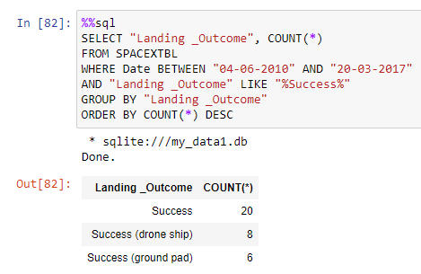
Rank Landing Outcomes Between 2010-06-04 and 2017-03-20
In this query we should use 2 conditions, a GROUP BY to group by “Landing _Outcome” and an “ORDER BY” to order the result by descending order.

Slide 34

Section 3

Slide 35
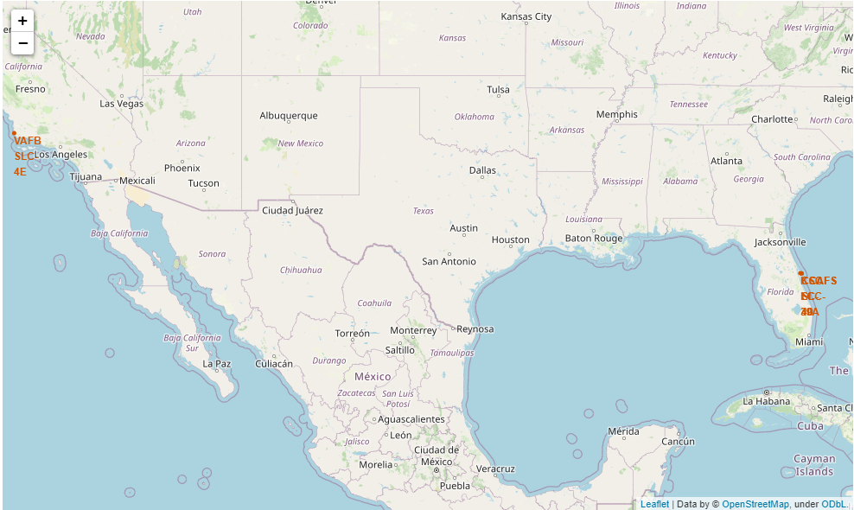
Launch sites’ location
The launch sites are located in coastal areas either at the east or the west of the US.

Slide 36
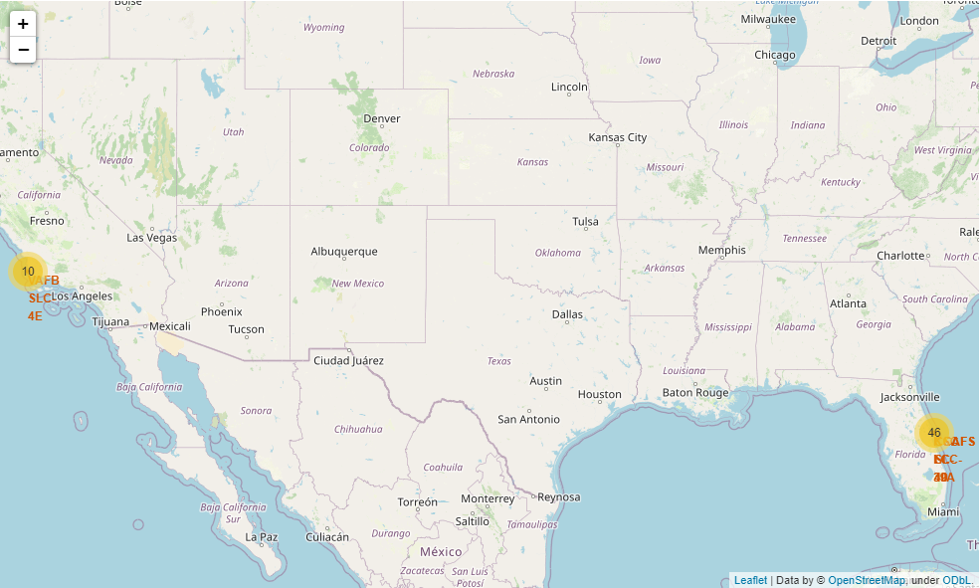
Success/failed launches for each site
The number of launches per launch site is displayed in this map. A zoom will be displayed in the next map where we can see the success (in green)/ failed (in red) launches for each site

Slide 37
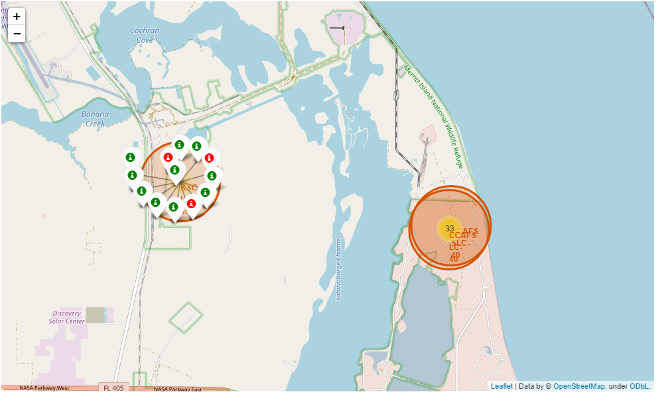
Success/failed launches for each site

Slide 38
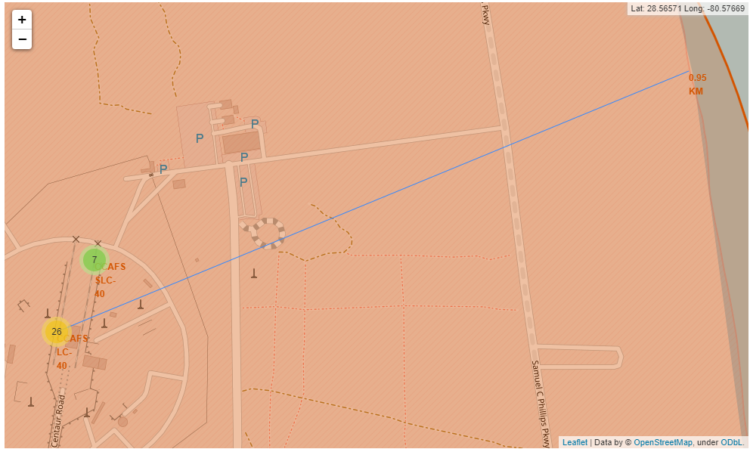
Distances CCAFS LC-40 and nearest coastline

Slide 39
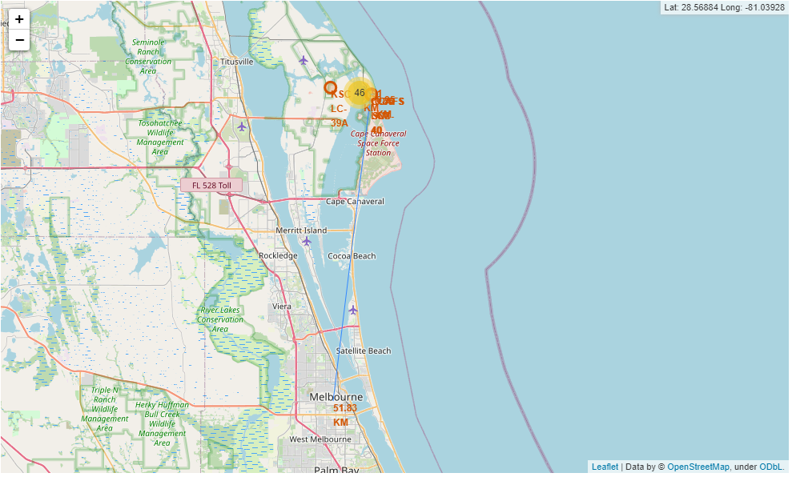
Distances CCAFS LC-40 and nearest city

Slide 40
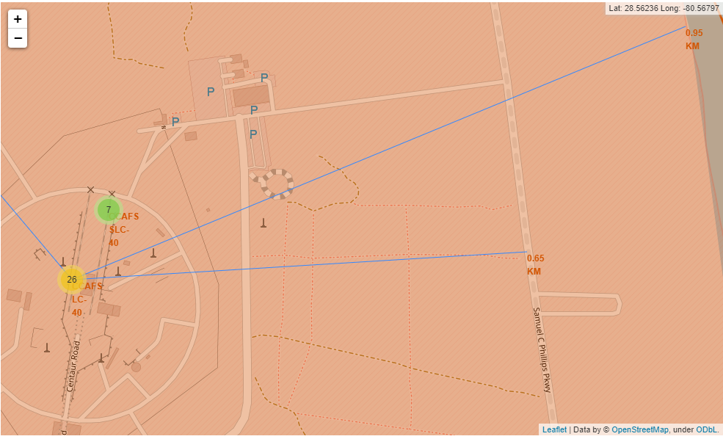
Distances CCAFS LC-40 and nearest highway

Slide 41
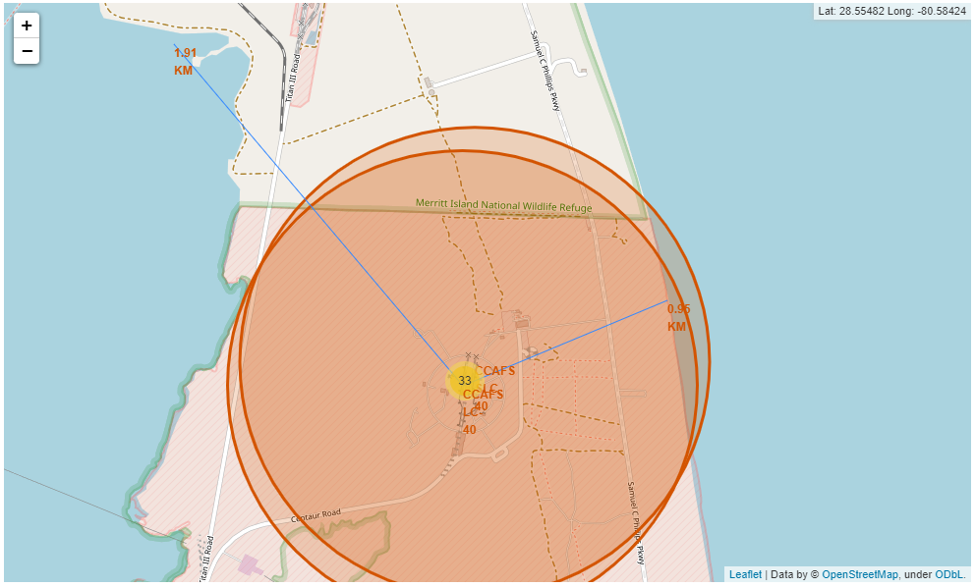
Distances CCAFS LC-40 and nearest railway

Slide 42

Section 4

Slide 43
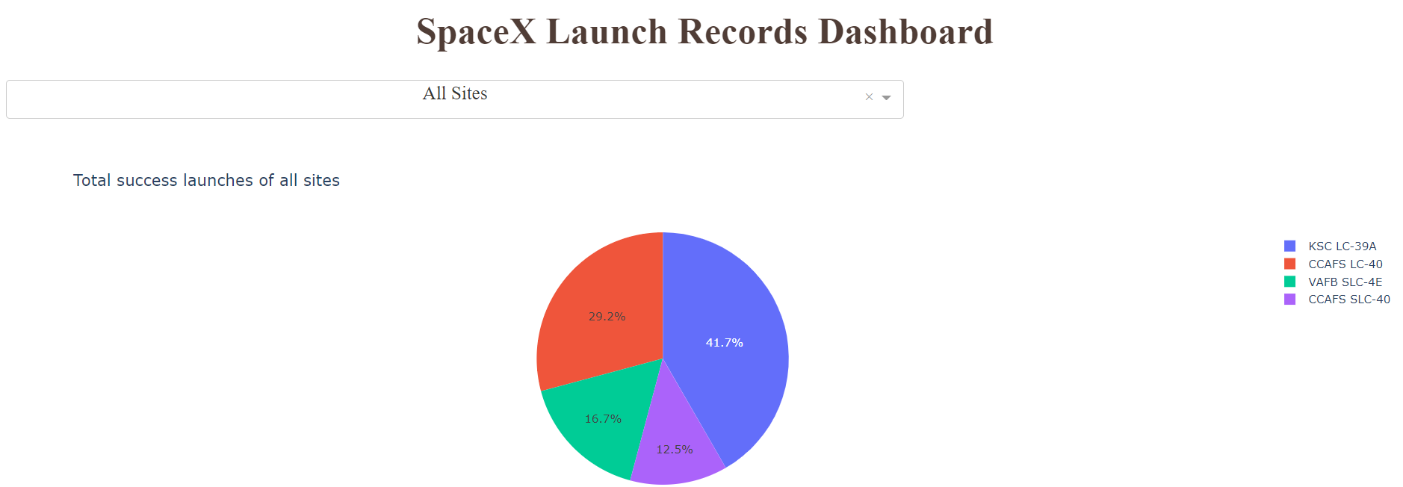
Total success launches of all sites

Slide 44
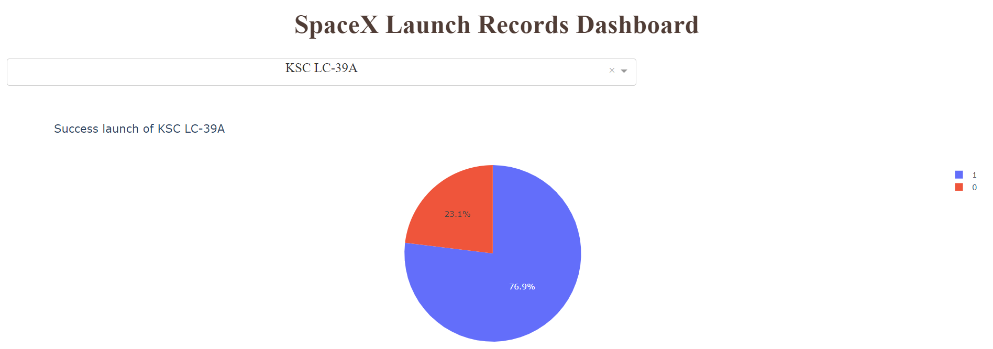
Launch site with highest success rate

Slide 45
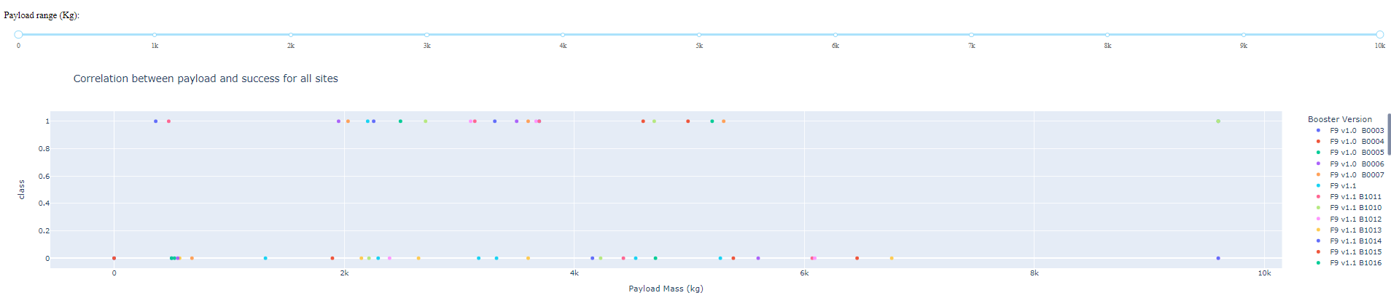
Correlation between payload and success for all sites
Different payload ranges and launch record dashboards are detailed in the Appendix.

Slide 46

Section 5

Slide 47
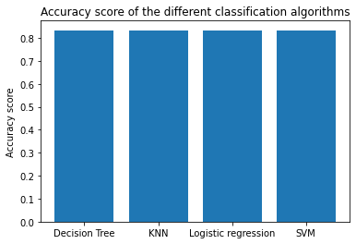
Classification Accuracy
All the models give the same accuracy result of 83.33%.
We can use the Decision Tree or any other algorithms as all the algorithms are giving the same accuracy.

Slide 48
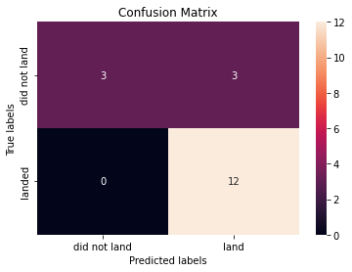
Confusion Matrix
The model correctly predicted all the landed rockets. It still has some erroneous predictions of the rockets that did not land with giving 3 false positive results.

Slide 49
Conclusions
This project aims to predict if the Falcon 9 first stage will land successfully depending on different parameters such as launch site, payload mass, etc.
Since 2013, Success rate kept increasing which means that Spacex landing technology is becoming more reliable through time.
Heavy payloads (greater than 10000 kg) have more change to succeed. As VAB SLC-4E never launched a rocket with a payload greater than 10000 kg, it is better to focus on the other launch sites especially KSC LC39-A which has the highest success rate.
Four classification models were used to predict the landing success depending on different parameters. All of them have an acceptable accuracy so they can be reliable to predict the success of a landing.

Slide 50
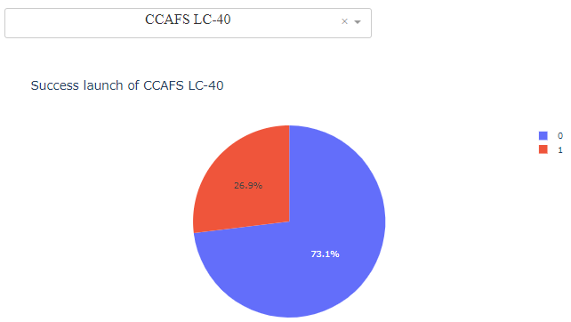
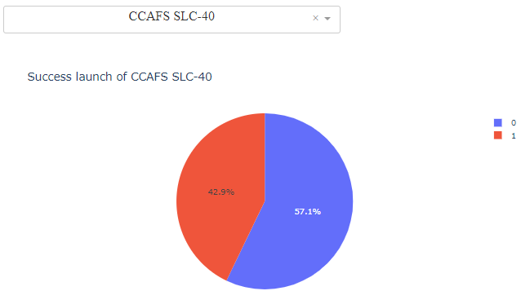
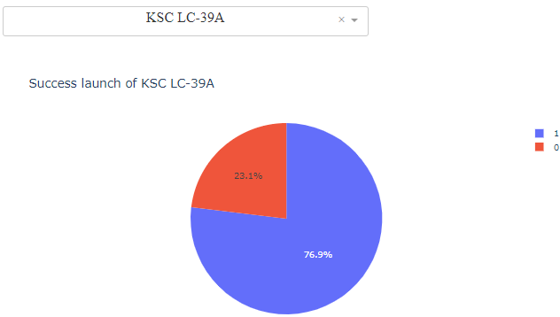
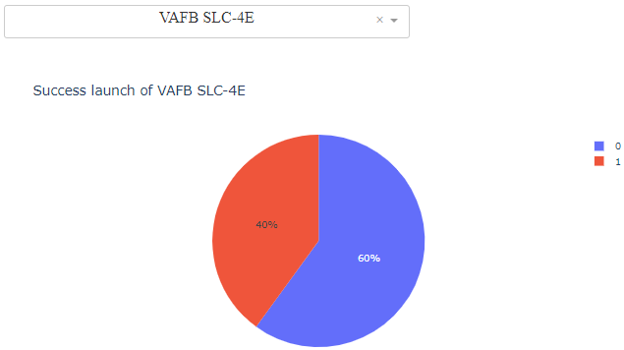
Appendix
Success rate of the 4 launch sites

Slide 51
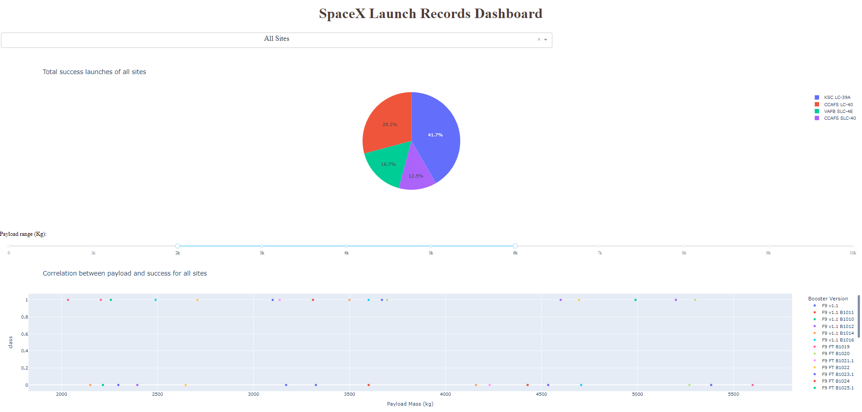
Appendix
Total success and correlation for payload between 2000 and 6000 kg

Slide 52
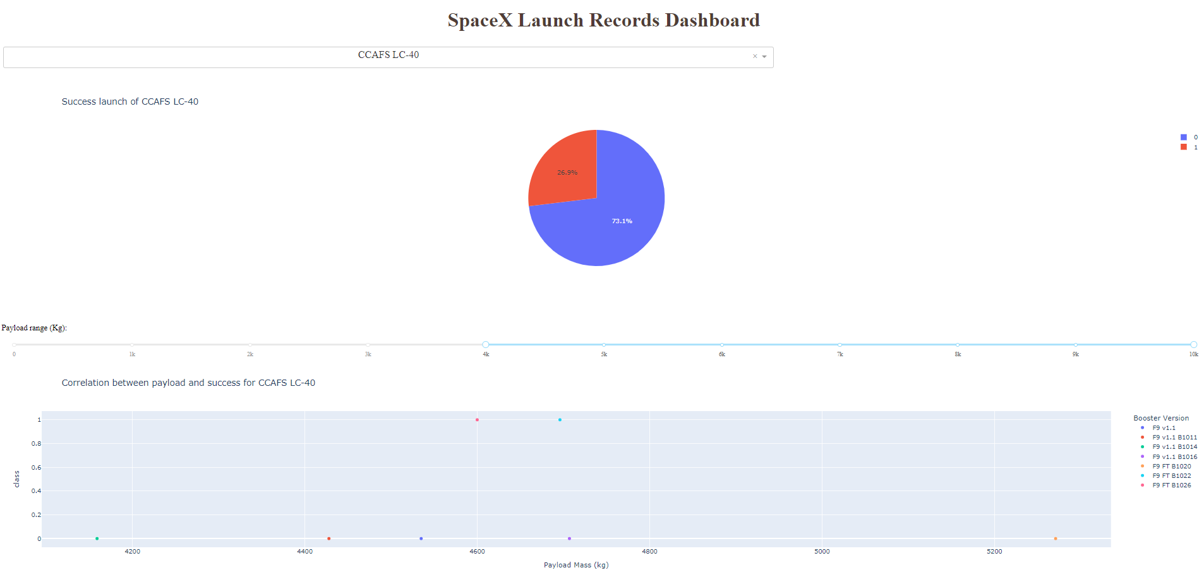
Appendix
Success and correlation for payload greated than 4000 kg for CCAFS LC40

Slide 53


